Slide 1

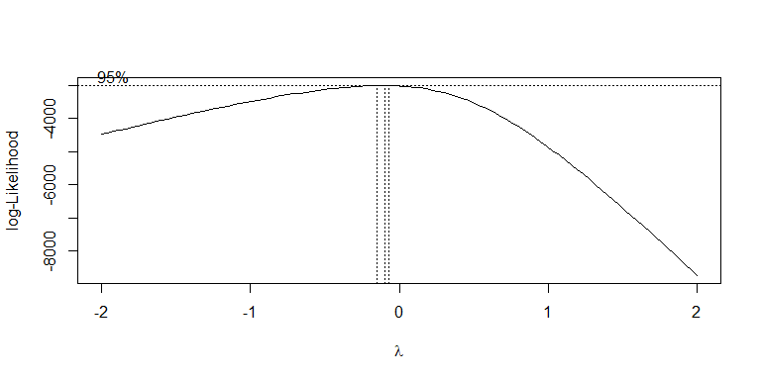
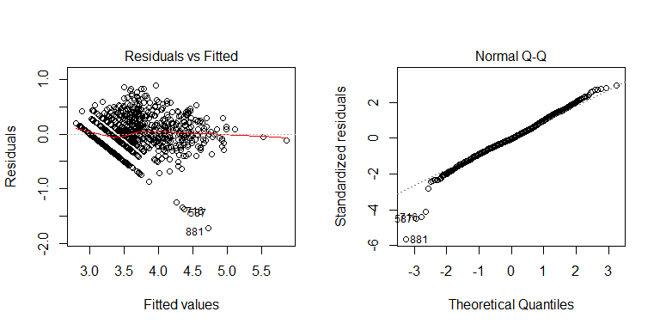
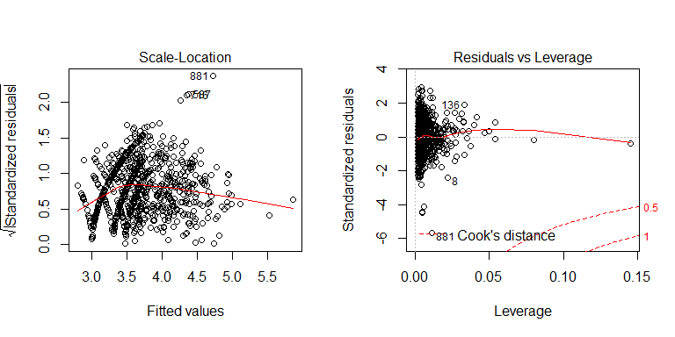
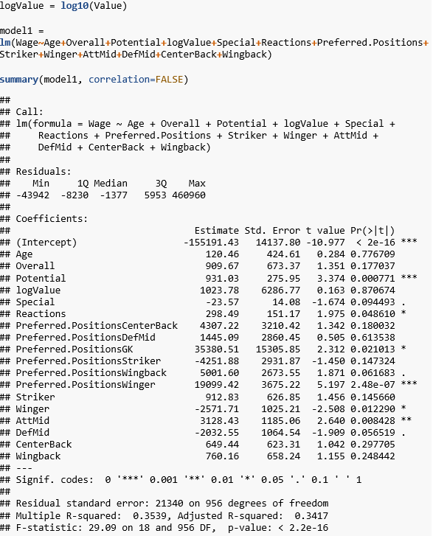
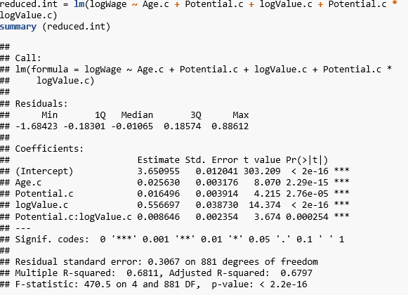
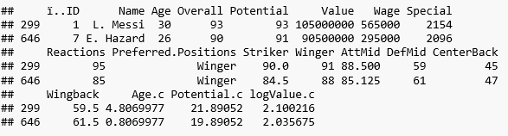
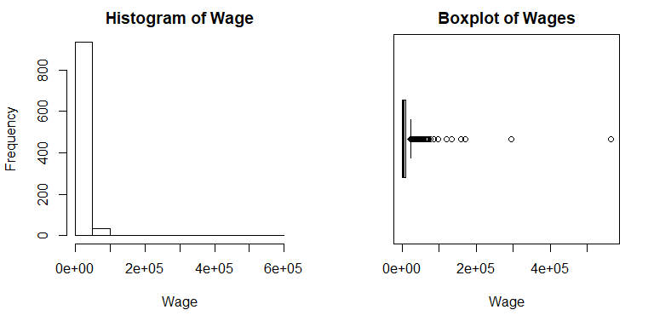
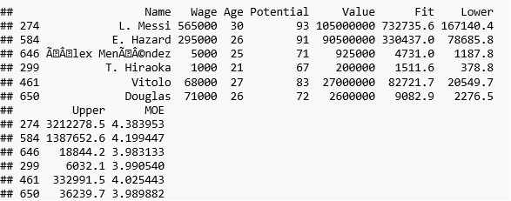
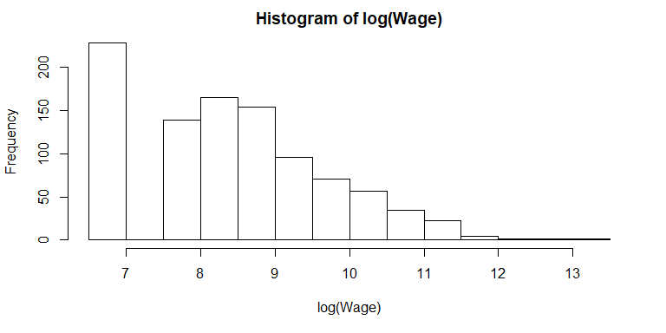
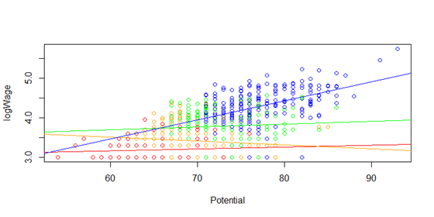
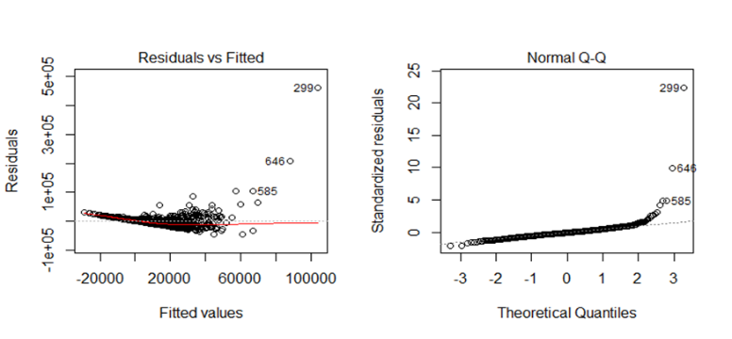
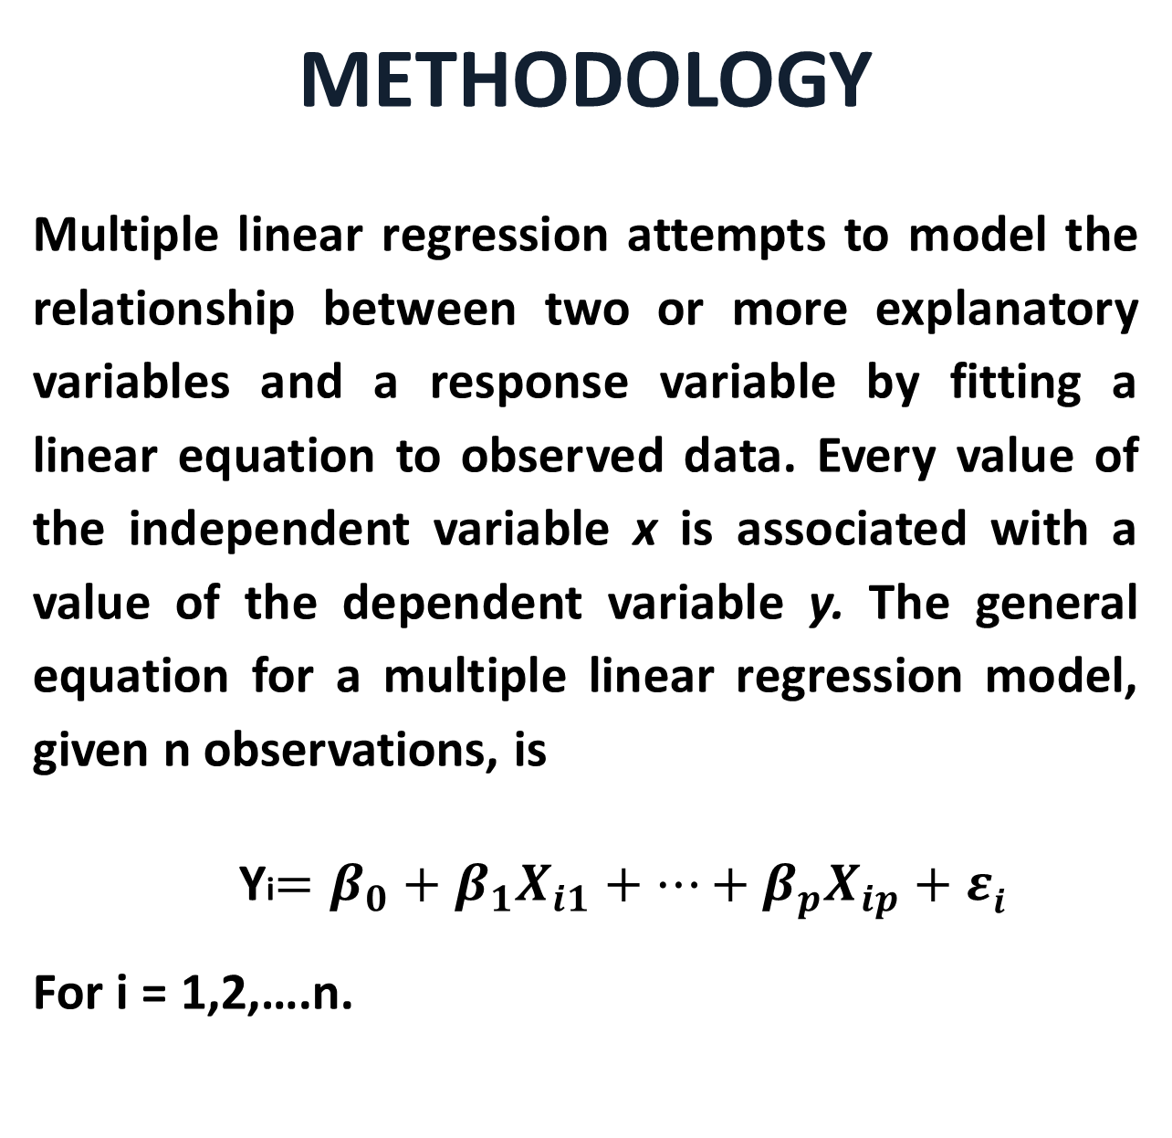
FIFA 18: Predicting Player’s wages with Linear Regression
Ahmad Osman, Beka Beriashvili, and Rafael Broseghini – Luther College
ABSTRACT
The purpose of this poster is to determine what attributes are most predictive of player’s wages, by generating simple and multiple linear regression models on FIFA 18 data obtained from kaggle.com. Multiple variables are available to find the best model to achieve our goal stated above. Based on that, we chose to examine Age, Nationality, Club, Overall rating, Potential Overall, Special, Value (Euros), Reactions and Preferred Positions. These are the most significant variables in predicting player’s wages in FIFA 18. There are around 1000 observations in the sample data set.
DATA CHARACTERISTICS
The following data were used in the analysis presented here:
Variable Name Description_______________________________________________________________
Wage (Response variable) Wage in Euros per week
Overall Overall rating of player from 0-99
Potential Highest Overall rating that player can achieve 0-99
Value Estimated value of player in the market in Euros
Special Sum of athletic attributes minus composure
Reactions Estimated value of player’s reaction to a play
Preferred Positions Position on the pitch where the player performs best
Striker ST, CF, RF, LF
Winger RW, LW
AttMid CAM, CM, RM, LM, RAM, LAM
DefMid CDM, RDM, LDM
CenterBack CB, RCB, LCB
Wingback LWB, RWB, LB, RB
______________________________________________________________
METHODOLOGY
Multiple linear regression attempts to model the relationship between two or more explanatory variables and a response variable by fitting a linear equation to observed data. Every value of the independent variable x is associated with a value of the dependent variable y. The general equation for a multiple linear regression model, given n observations, is
Yi$=β_{0}+β_{1}X_{i1}+…+β_{p}X_{ip}+εi$
For i = 1,2,….n.
MODEL DIAGNOSTICS
The residuals vs fitted values suggests a better variance than the first order model. The red line is close to 0. Normal Q-Q plot suggests a few outliers and distribution looks more normal.
The residual analysis of the first order model suggested some problems with the model as well. The residuals are not symmetrically distributed showing non-constant variance. The presence of outliers might also be skewing the model.
INITIAL MODEL FIT
First, we fit a first-order linear model with all predictors.
The Box-Cox analysis suggested a transformation on the response variable of lambda = -0.2. The results of the Box-Cox transformed model was not better then the log-Transformed model. A stepwise backward elimination was performed on our log transformed model. Following, the model was refit now with interactions and each variable was centered. The last is the best model, which is displayed below.
The Residuals vs Leverage plot suggests two points that may be above the cutoff for cook’s distance. Through calculation (2*sqrt(5/886)) we discovered that these points were below the cutoff and investigating the data frame we found out which players they were.
Predictions for six players were done, which suggested some interesting results like the fact that the fit for Douglas, a medium potential player in a high-payroll club not be in the Lower-Upper interval.
The analysis of coefficients test above suggests that Potential, Reactions, Preferred.PositionsWinger, and AttMid are the highest significant predictors of a player's Wage. The R-squared is 0.3539, with adjusted R-squared = 0.3417, which indicates that little of the variability in Wage is being explained by this model.
We tried a stepwise backward elimination on our best model to verify no other possible changes to it. Indeed, no further changes were needed. When compared to the first model, the R-squared for this model is indeed better. R-squared = 0.68.
CONCLUSION
Establishing players’ wages is at the forefront of transactions and contracts in the soccer world. With salaries increasing worldwide, as what is being named as a “soccer bubble” problem, efforts in trying to establish the correct wage amount for each player is recommended. This model provides an opportunity to mildly obtain such Wage value. The information from this model can be somewhat helpful to help decide the correct amount a player should be payed, therefore preventing an exponential inflation of the “soccer bubble”.
To go into further detail, one could perform similar testing on a larger sample size. With the data set we used, we found what we believe to be the most descriptive model with the least amount of predictor variables.
MODEL SELECTION
The LogWage vs Potential slope is the steepest for high value players and not steep for other value players. Blue – Highest value players. Green – Medium value players. Orange – Medium/Low value players. Red – Low value players. We notice a spread of players that receive minimum wage in the model and some outliers that are not above the cut-off for Cook’s distance. We also notice there is a higher correlation between high value players’ wages and potential than players with medium and low values.
Distribution is extremely right skewed, while the distribution of Log Wage is more symmetric although still moderately right skewed. There is a high frequency bin on the left of the histogram log, that may be explained by the players that have just moved up from the academy teams into the professional team and receive minimum wage.

